Slide 1
Customer Churn Analysis
By Talal Zubairi & Meenakshy Liju

Slide 2
Table of contents
01
02
03
Introduction
Project Planning
Sprint 1
04
05
06
Sprint 2
Web Application
Review
Introduction to case study and team roles.
Agile Scrum approach using Taiga.
Dashboard 1 & Logistic Regression model
Dashboard 2 & Random Forest Model
Using Random Forest
Model
Project review and retrospective

Slide 3
Introduction
Our case study is Predictive Analytics for Customer Churn. The dataset is sourced from Kaggle.
Initial research findings:
Customer churn is a prevalent issue that is faced by many companies that have critical financial consequences.
By predicting churn, businesses can implement targeted retention strategies to minimise customer loss.
Goals:
Design two insightful dashboards for churn analysis and customer retention.
Develop and implement two classification models for predicting customer churn and evaluate which is more ideal.

Slide 4
Project Management Tools
Project Charter
Team Contract
Skills Audit
4. Risk Register
5. Weekly Diaries
6. Taiga

Slide 5
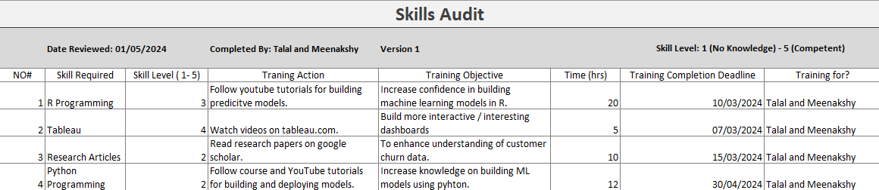
Skills Audit

Slide 6
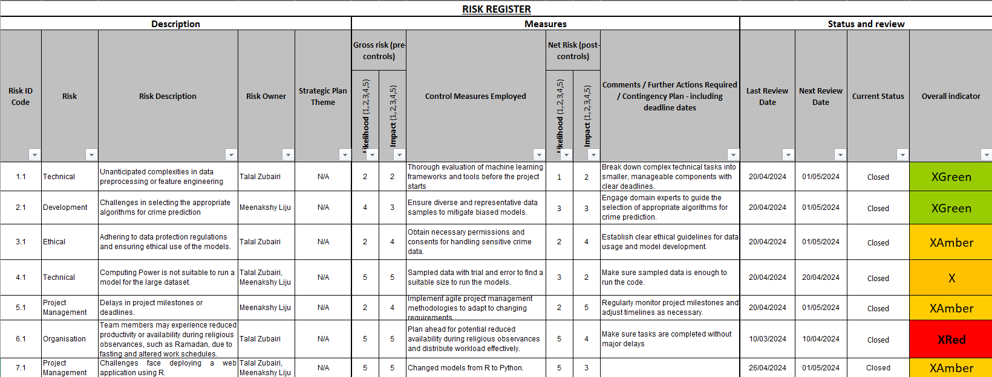
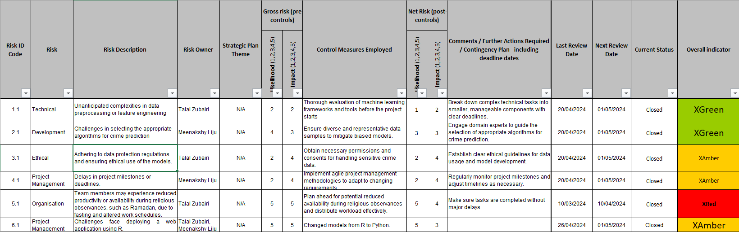
Risk Register

Slide 7
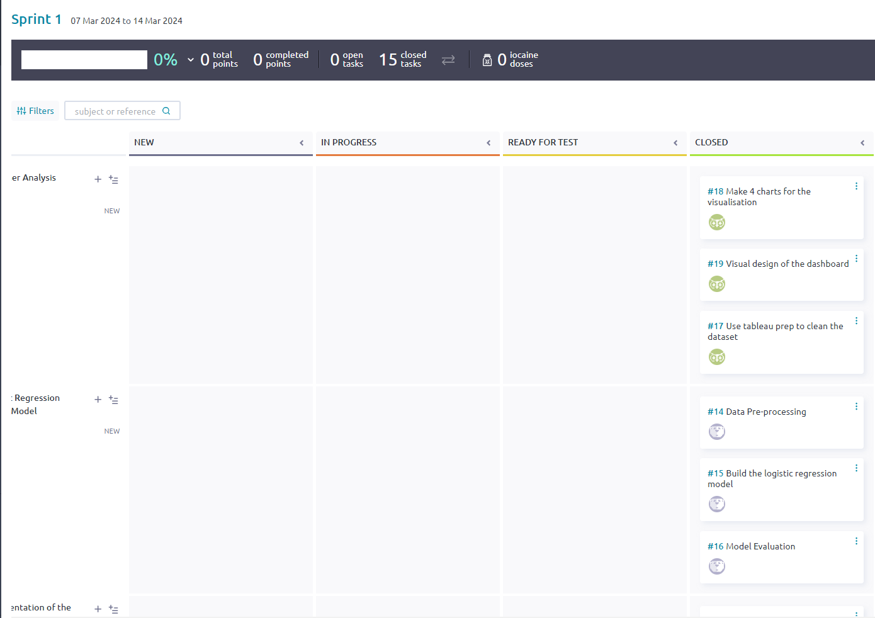
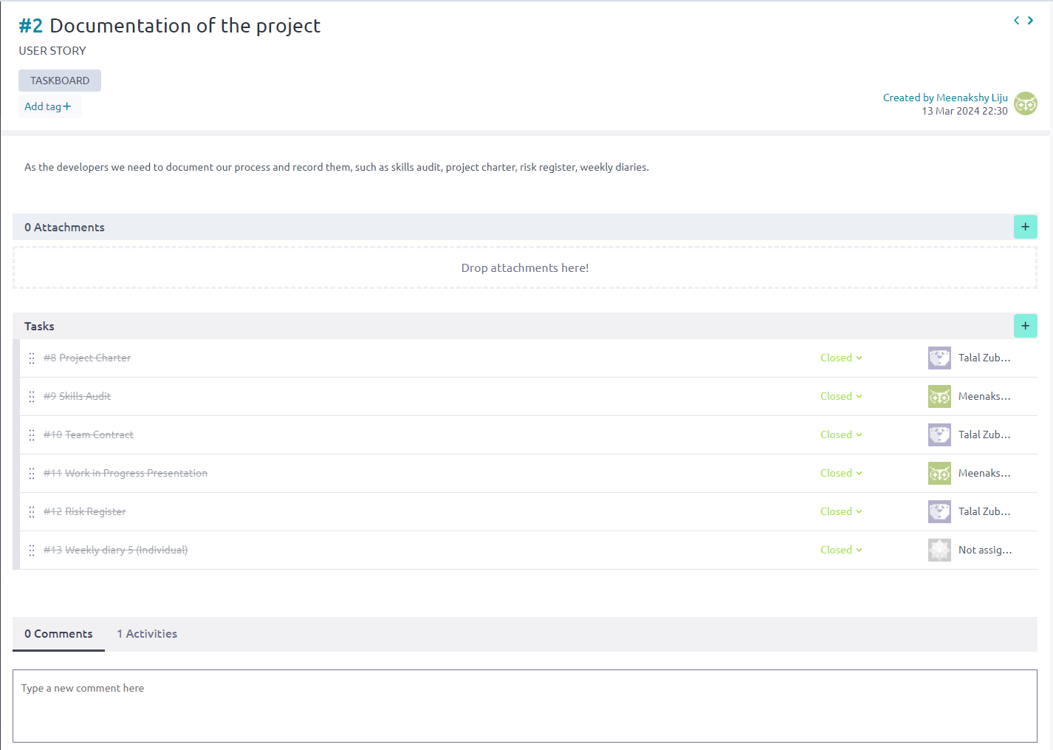
Project Planning using Taiga
Sprint 1
User Stories

Slide 8
Sprint 1

Slide 9
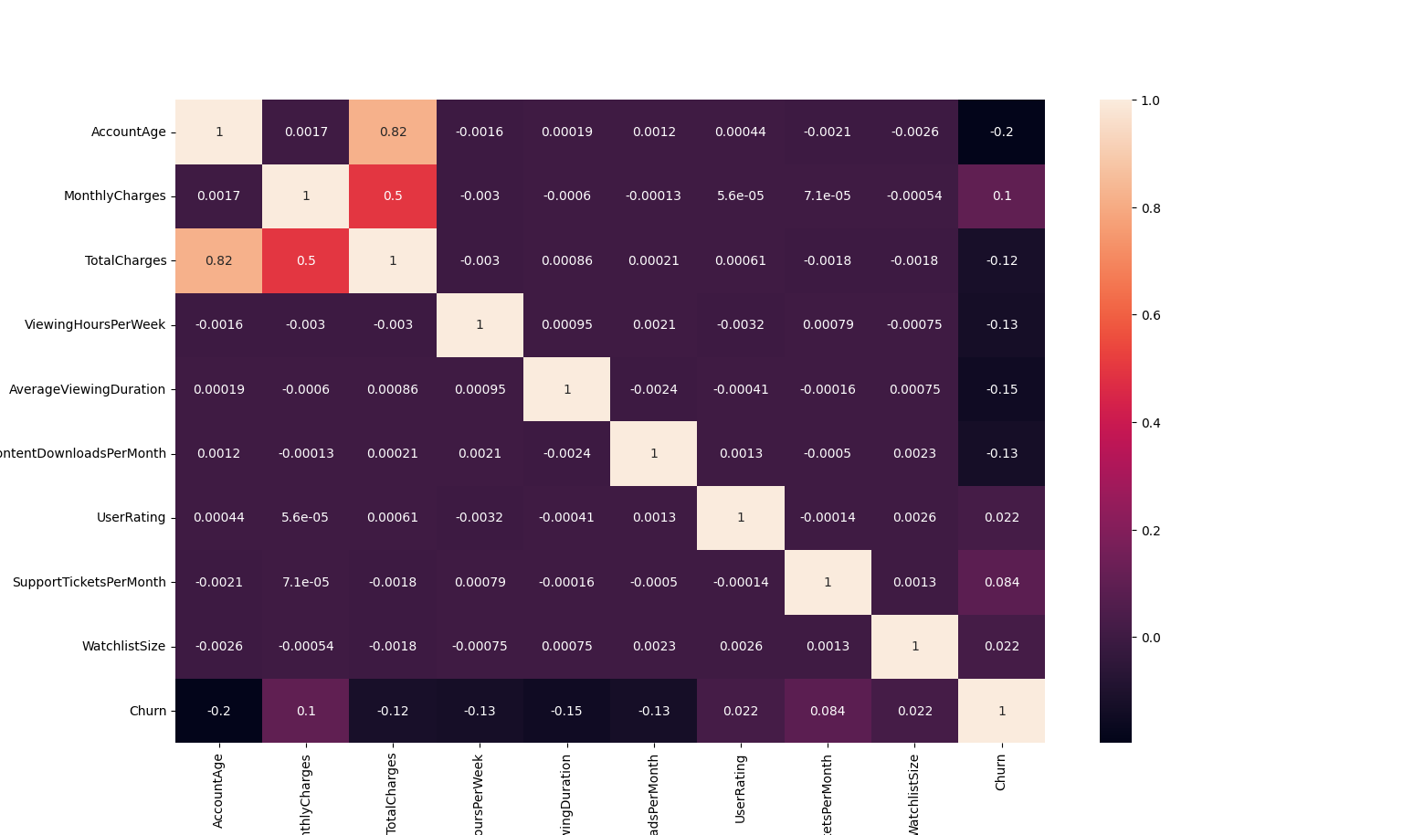

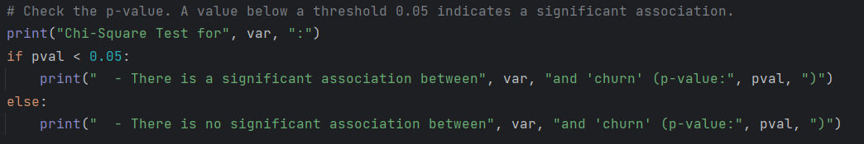
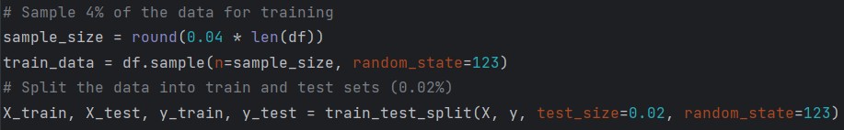
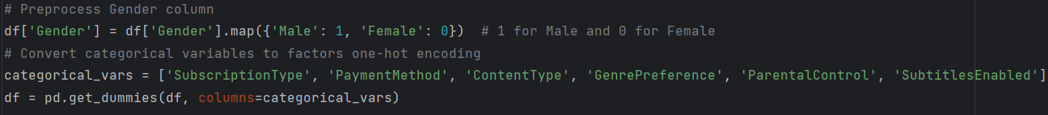
Data Pre-Processing
Checked for missing values
Feature Selection
Encoding categorical variables
Sampled Data

Slide 10
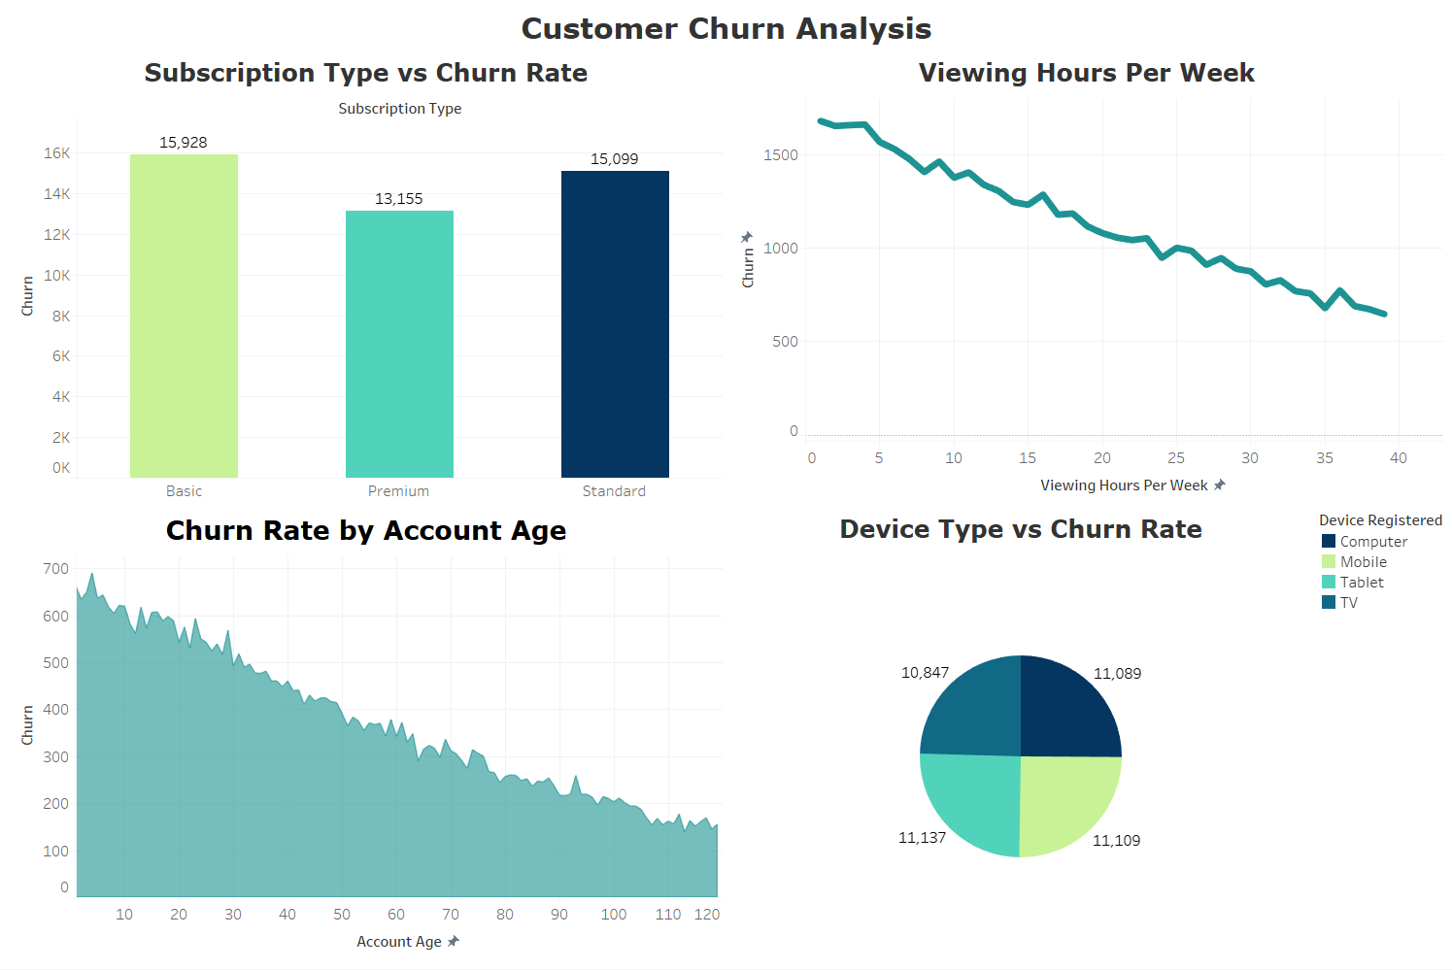
Customer Churn Analysis Dashboard
Identifies which subscription types are most at risk
Basic has the highest followed by standard & premium
Graph can be used to segment customers
Offer personalised reccommendations, early access to content / features.
Loyalty programs
Churn rates decrease with time
Customers may not have found value in the service straight away
Identify areas for improvement in the early stages
Investigate usability issues with devices
High churn rates for mobile devices could indicate limitations such as small screens that limit user experience.

Slide 11
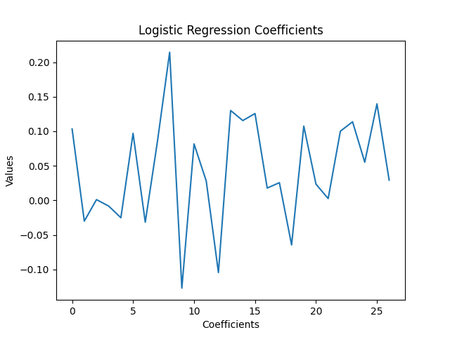
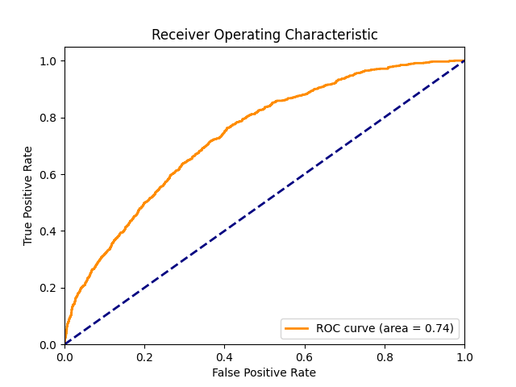
Logistic Model

Slide 12
Sprint 2

Slide 13
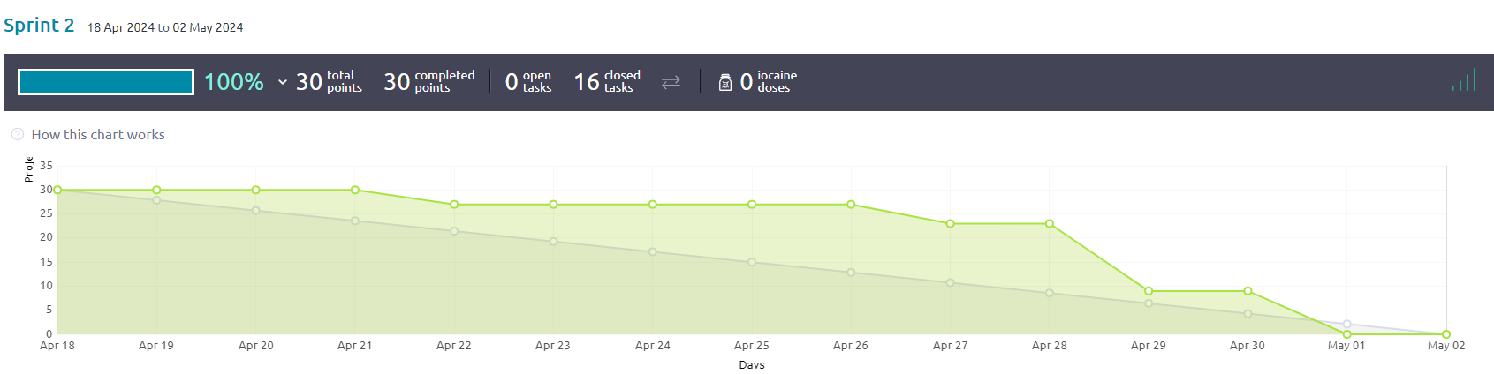
Sprint 2 Burn Down Chart

Slide 14
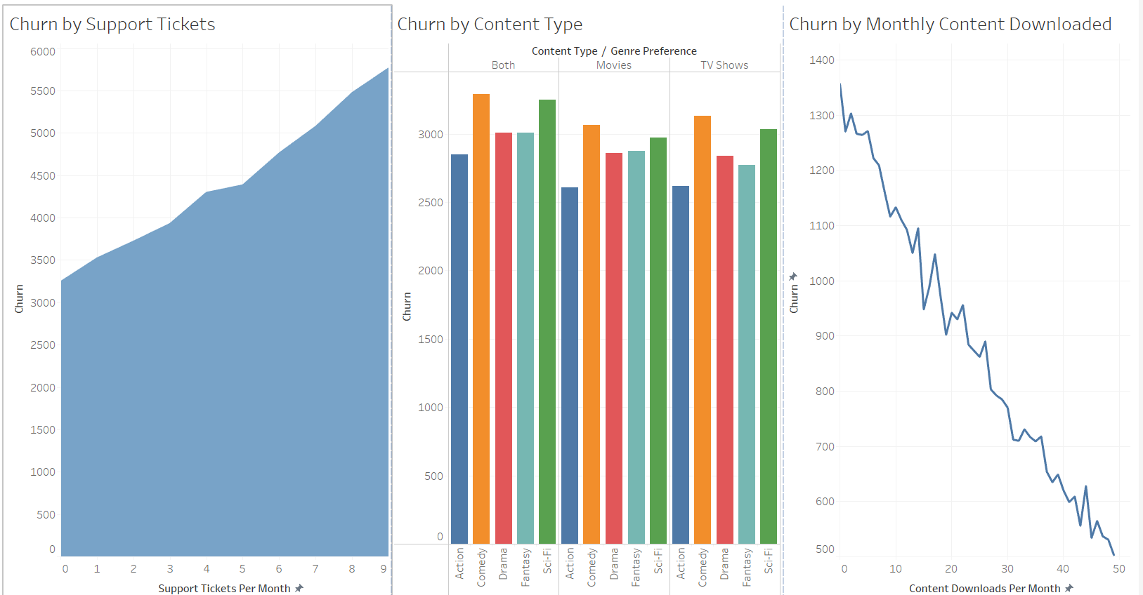
Churn Analysis Dashboard 2

Slide 15
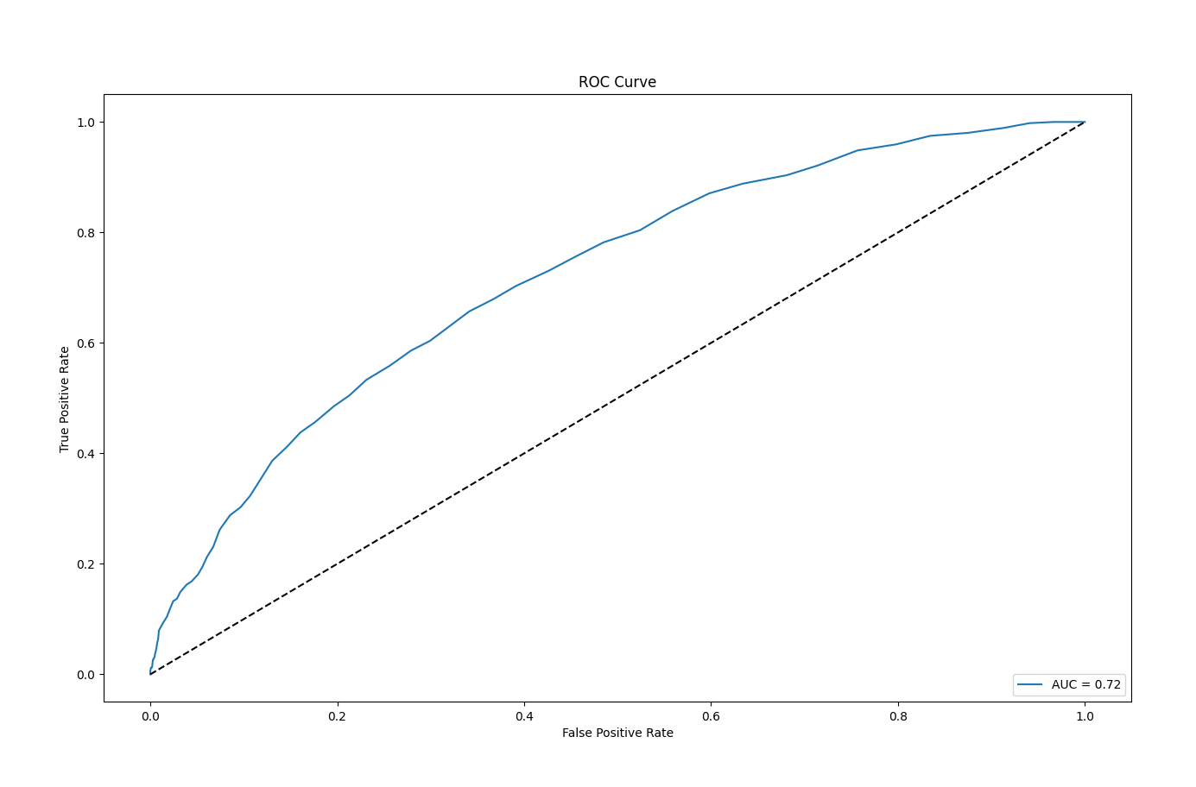
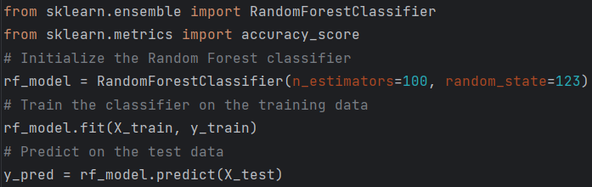
Random Forest Model

Slide 16
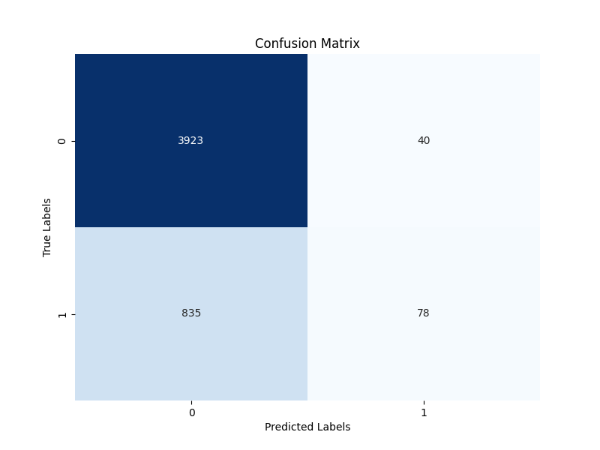
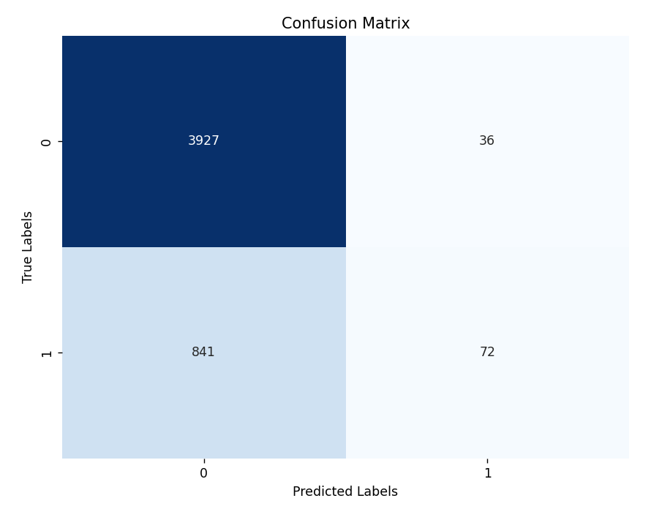
Model Comparison
Model 1 – Logistic Regression | Model 2 – Random Forest
Accuracy: 0.81 | Accuracy: 0.82
Precision:0.61 | Precision: 0.66

Slide 17
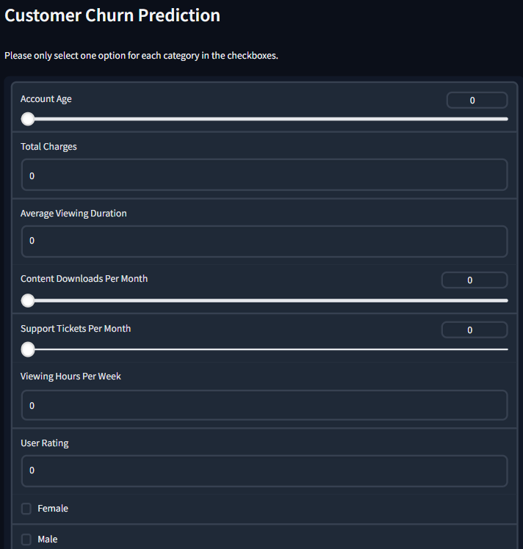
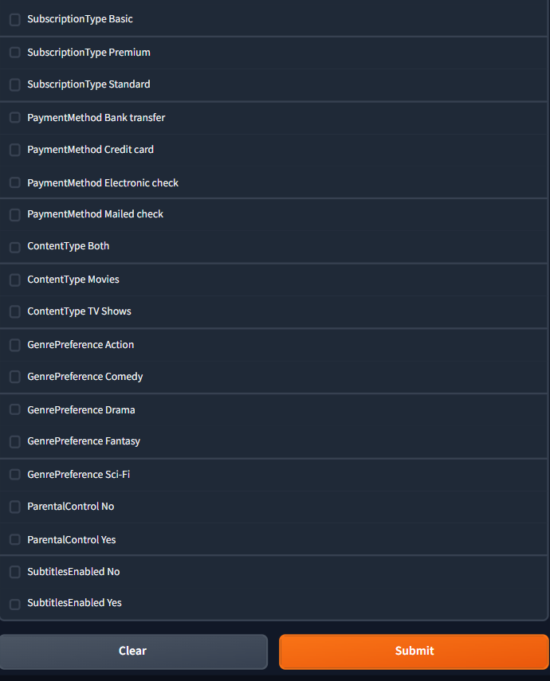
Web Application using Gradio

Slide 18
Review and Retrospective
Completion of Dashboards and Predictive Models
What went well?
The team overcame the data hurdle and completed sprint 1 on time.
Efficient allocation of tasks between team members.
Quickly adapted to switching our models to python
What needs improvement?
Web application's interface
Time management
Key learning points:
Importance of thoroughly examining the correlations between variables to ensure optimal model performance and accurate output.
Improved understanding of programming languages

Slide 19
References
Safrin S, Predictive Analytics for Customer Churn: Dataset. Kaggle: https://www.kaggle.com/datasets/safrin03/predictive-analytics-for-customer-churn-dataset
Alshamsi, A. (2022) Customer Churn prediction in ECommerce Sector . Thesis. Rochester Institute of Technology. [Online]. pp. 2-25. Available from: <https://repository.rit.edu/cgi/viewcontent.cgi?article=12319&context=theses> [Accessed 08/03/2024].

Slide 20
Thank You!

